Slide 1


Git Installation
myshow4all​

Slide 2
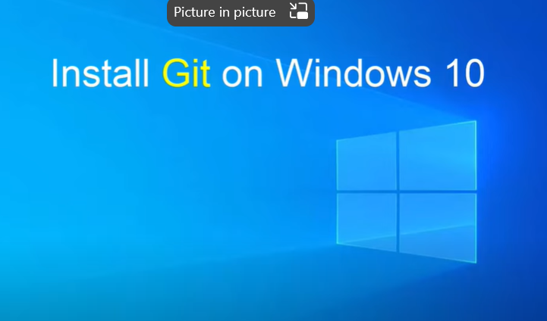
Agenda

Slide 3
Agenda

Slide 4
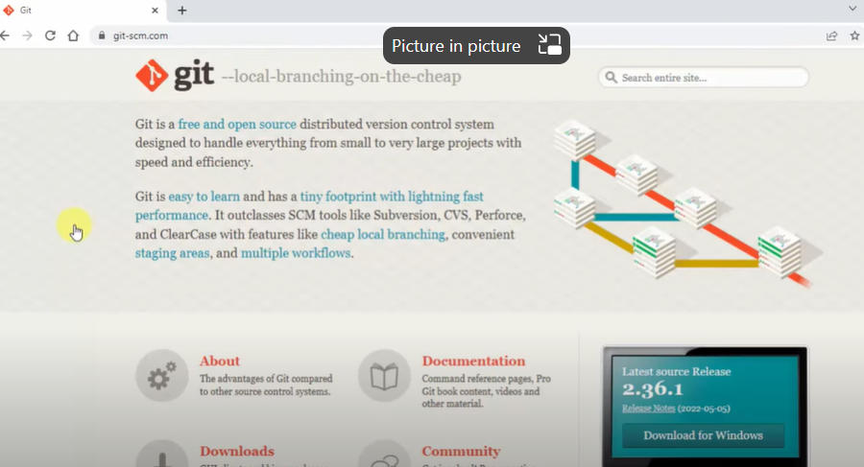
Agenda

Slide 5
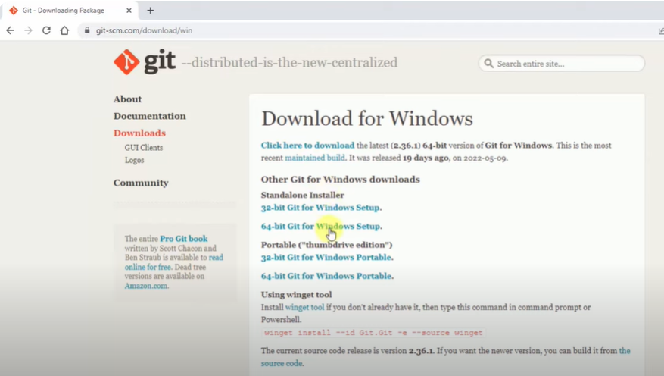
Agenda

Slide 6
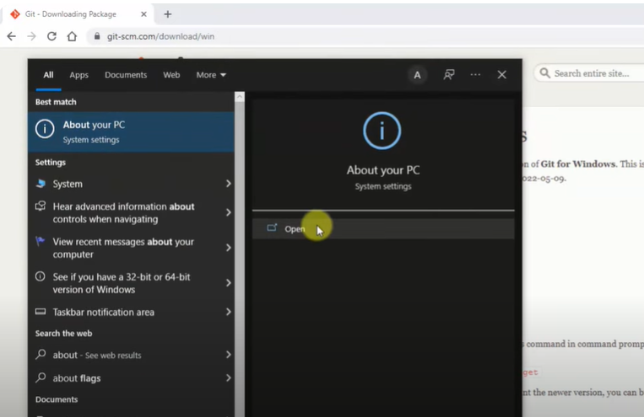
Agenda

Slide 7
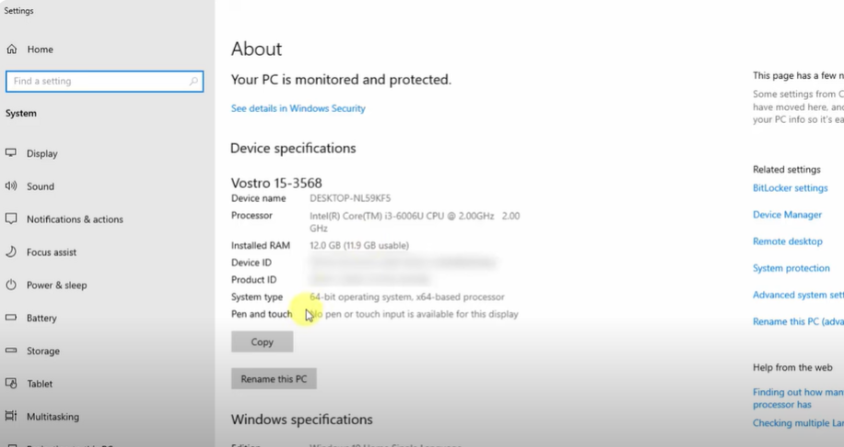
Agenda

Slide 8
Agenda

Slide 9
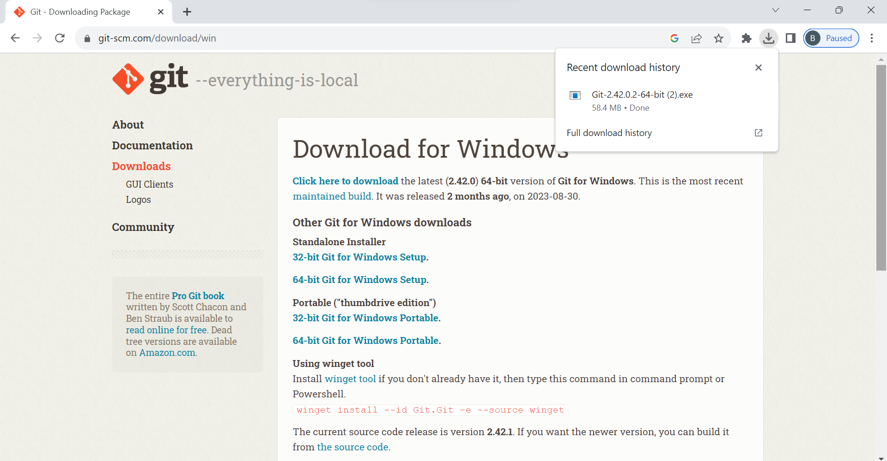
First, click here
Then, double click here

Slide 10
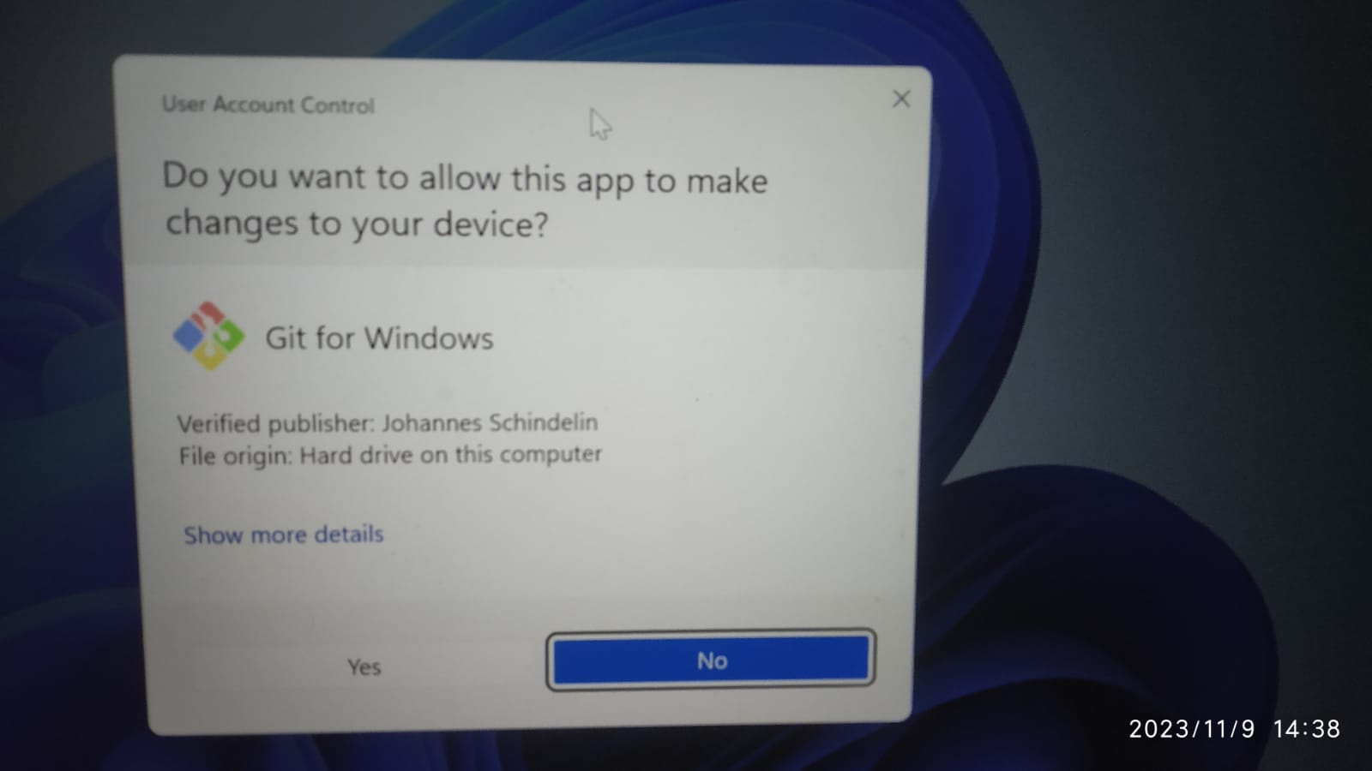
Click “Yes”

Slide 11
Agenda

Slide 12
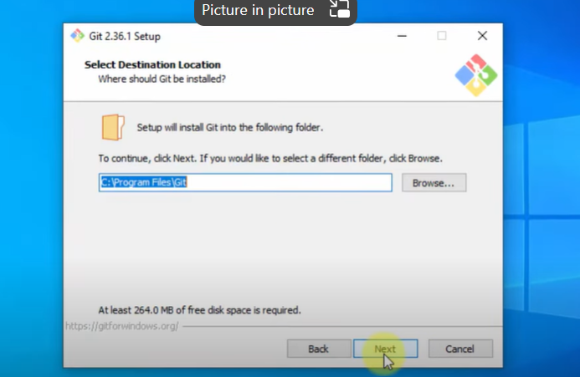
Agenda

Slide 13
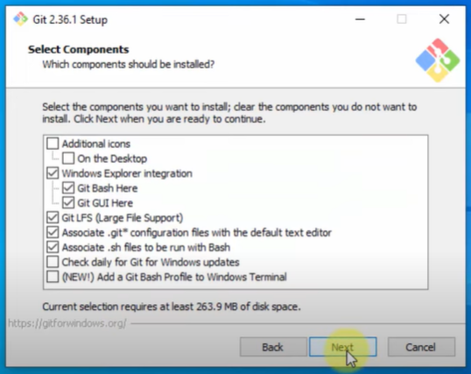
Agenda

Slide 14
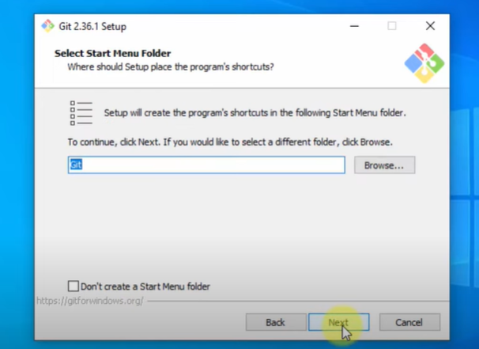
Agenda

Slide 15
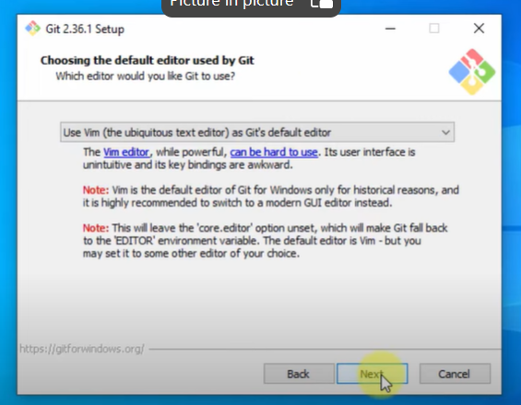
Agenda

Slide 16
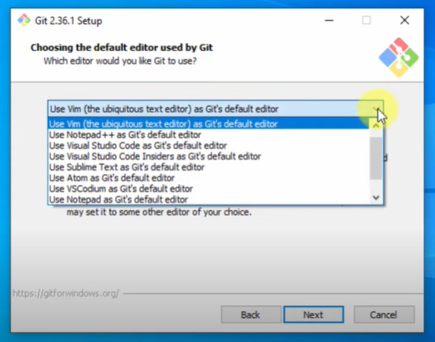
Agenda

Slide 17
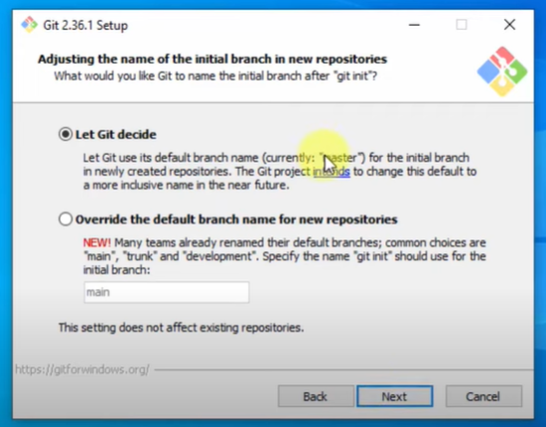
Agenda

Slide 18
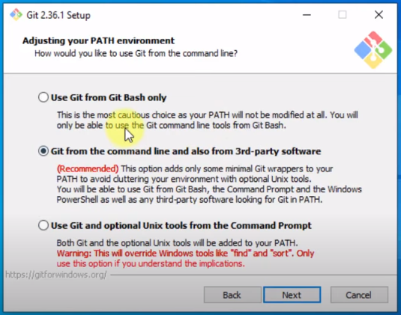
Agenda

Slide 19
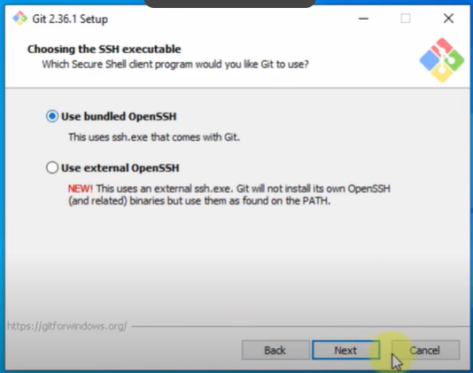
Agenda

Slide 20
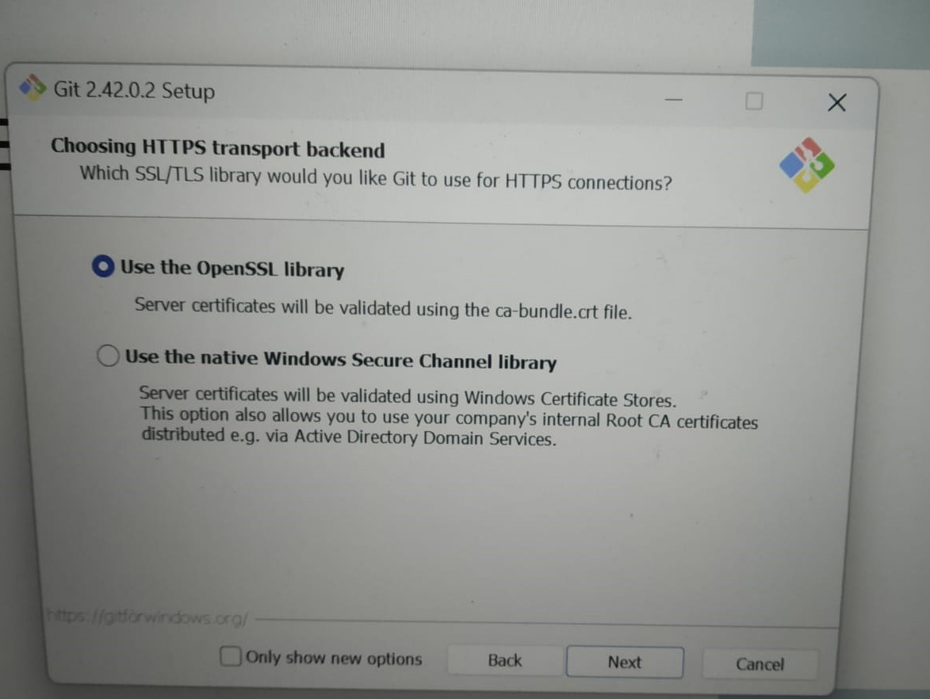

Slide 21
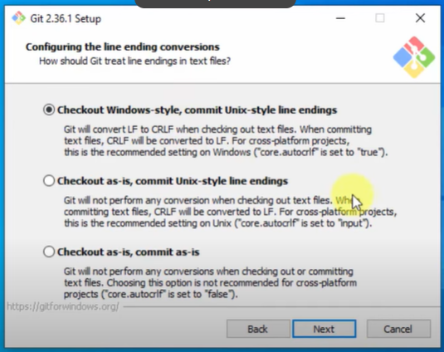
Agenda

Slide 22
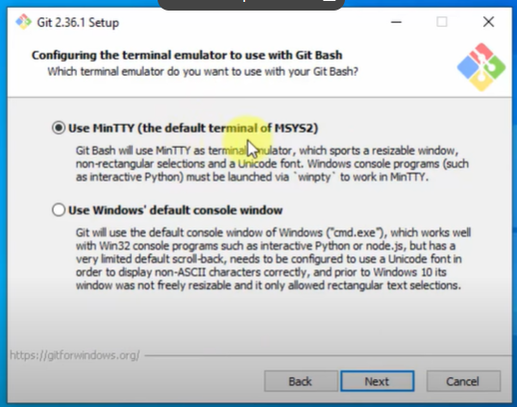
Agenda

Slide 23
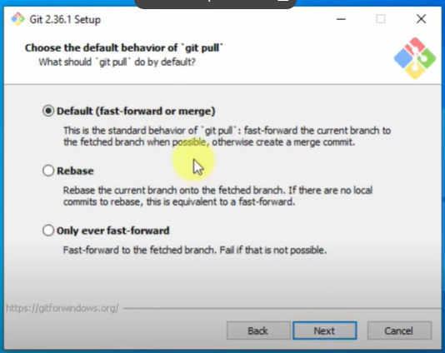
Agenda

Slide 24
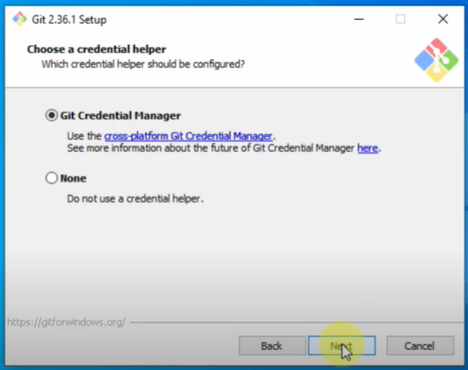
Agenda

Slide 25
Agenda

Slide 26
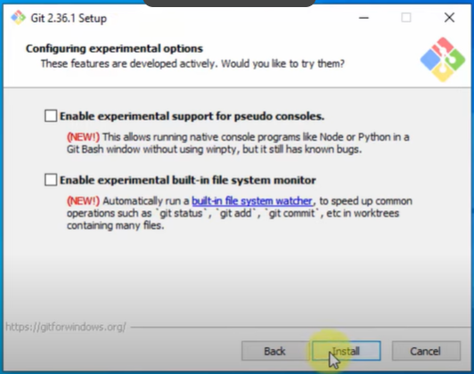
Agenda

Slide 27
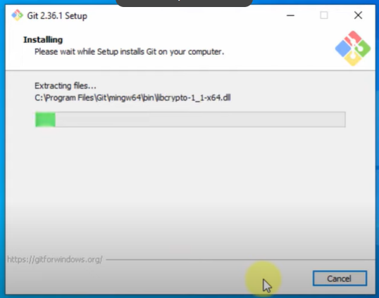
Agenda

Slide 28
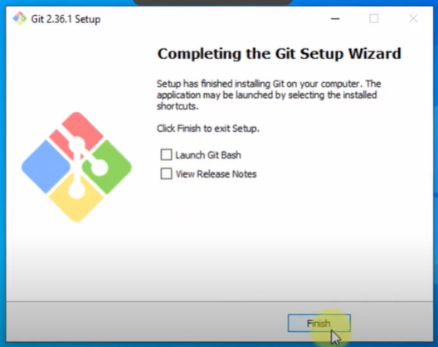
Agenda

Slide 29
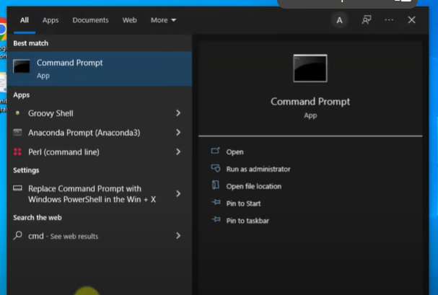
Agenda

Slide 30

Open command prompt and enter your global configurations
Git Global Configuration
git config -- global user.name “myshow4all”
git config --global user.email “myshow4all@example.com”

Slide 31

Meet our team
Krishna
Sunil
Vamsi
Vijay
Project Manager
Chief Executive Officer
Branch Manager
VP Marketing

Slide 32
Git Global Configuration
git config --global user.name “myshow4all”
git config --global user.email “myshow4all@example.com”

Slide 33


Thank you
MYSHOW4ALL.COM

